Slide 1
Final Project 2:
Exploratory Data Analysis on University Rankings
Yvonne Gan • 19.09.2020

Slide 2
Part A: Data Understanding and Exploration

Slide 3
Exploratory Data Analysis
Key elements:
Inspect
Understand the dataset
Exploring the data
Experiments of the data
Next Step?

Slide 4
Methods I used for EDA on the dataset:
.head()
.tail()
.shape
.describe()
.isnull().sum()
.value_counts()
.isnull().any(axis=1)
.dtypes
.info()
.sort_values()
Notes:
.head() - To see how’s the dataset looks like
.tail() - To see how’s the dataset looks like
.shape - To see how many rows and columns in this dataset
.describe() - To get an overview of the data info, any solid/usable values
.isnull().sum() - To check any missing values
.value_counts() - Used this to get a view on the Sum of countries
.isnull().any(axis=1) - broad_impact with missing values, wanted to see what are the correlated info with the missing values.
.dtypes - To see what’s the types of the dataset
.info() - To get a broader view of the data types and information
.sort_values() - Used this on further inspect on the broad_impact column, in order to determine and needs to replace those NaN results.

Slide 5
Conclusion of Data Exploration:
Outcome
Understood the type of date
Overview on data usage
Explored methods for other parts
Learnt from mistakes
Exploration do not stopped here but continue throughout the analysis
Notes:
Understood the type of date - int, float, object/string
Overview on data usage - what and how can I use them for exploration
Explored methods for other parts - (Question Part A & B)
Learnt from mistakes - (Index the world_rank and realized it’s wrong)
Next Step:
Because during the analysis, I realized that during the process of entire project I got to explore more and understand more of the dataset.

Slide 6
Part B: 6 Questions

Slide 7
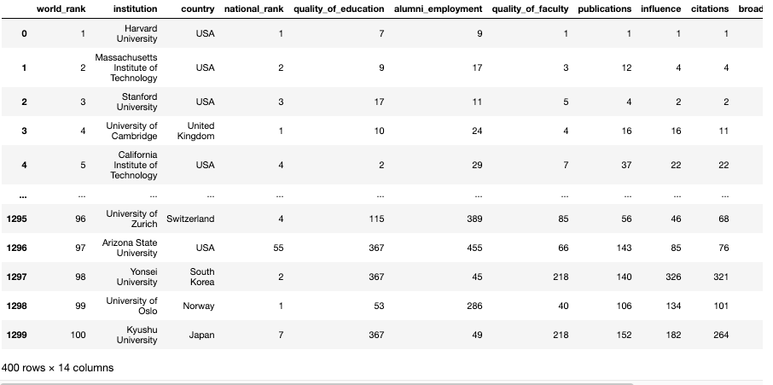
Question 01:
Which country (throughout all years) has the most number universities within top 100 of world_rank?
Created the count_100 variable
The variable contains - filtered of dataset for top 100(inclusive) world_rank across the years
Notes:
Requirement was to create variable call “count_100”
From 2200 of rows narrowed down to 400 rows
Every top 100 universities on each year

Slide 8
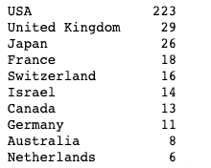
Question 01:
What are the top 10 countries by value of count_100?
To get the count of countries from the top 100 universities across all years
Value counts by the “country” column and from the output show the top 10 countries
Notes:
First, I did .value_counts() on the country column from the “count_100” (top 100 universities across all years) dataset. Once I got the list of counts on countries from count_100 dataframe, I narrowed down to the top 10 countries.

Slide 9
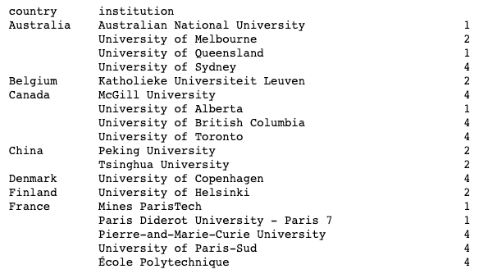
Question 01:
What is count_100 for each of these countries?
An overview of the top 100 universities under these countries
Groupby “country” followed by “institution”, then do the count by “institution”
Notes:
My understanding on this question is to do counting of how many times each university made into the top 100 (count_100) ranking across all years (because it’s asked under count_100) and list them out by country.
Therefore, I used the count_100 to do a groupby on “country” followed by “institution” then do the counts by “institution”

Slide 10
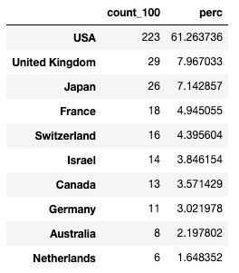
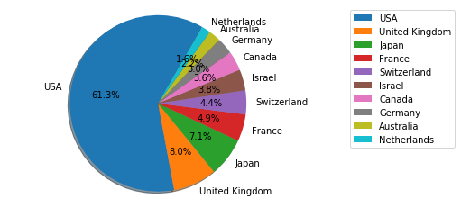
Question 02:
What is the percentage composition of each countries' count_100 out of the 10 countries?
Using previous statement on top 10 countries with largest amount of top 100 university and rename the count column to “count_100”
Formula: (Count of top 10 countries with top 100 university/ Sum of top 100 university in top 10 countries)*100
Notes:
Calculate the percentage of count_100(top 100 across all years) in the top 10 countries. As you can see USA is the highest % and even more than half of it.
And I took an extra step to create pie chart just to get a visual view of the percentage, I was curious to see the contrast.

Slide 11
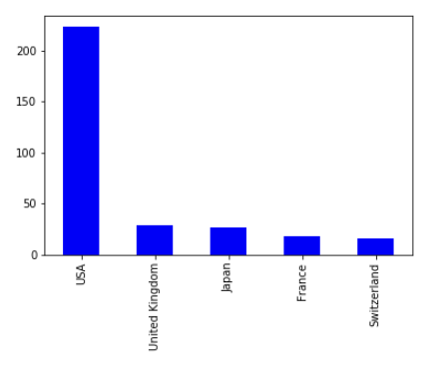
Question 03:
Plot a graph showing the top 5 countries from Q1 and their counts
From Q1 the list of Top 100 Universities, get the top 5 countries and plot a graph
Chosen “Bar Graph” - simple and easy overview
Notes:
From this bar plot/graph, it shows me the clear picture of despite being the top 5 countries, USA really has the highest number of University across all years that made into Top 100 world rankings.

Slide 12
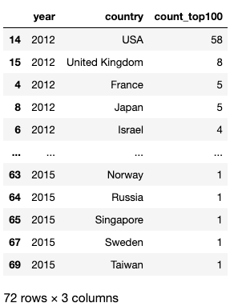
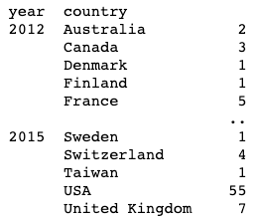
Question 04:
Groupby year and country showing the count of universities with world_rank within top 100 for that country and year.
Groupby year → country → count the numbers of universities (Pic 01)
Sort the year in ascending order while count_top100 in descending order.
Sort the year then counts to get table as Pic 02
Pic 01
Pic 02

Slide 13
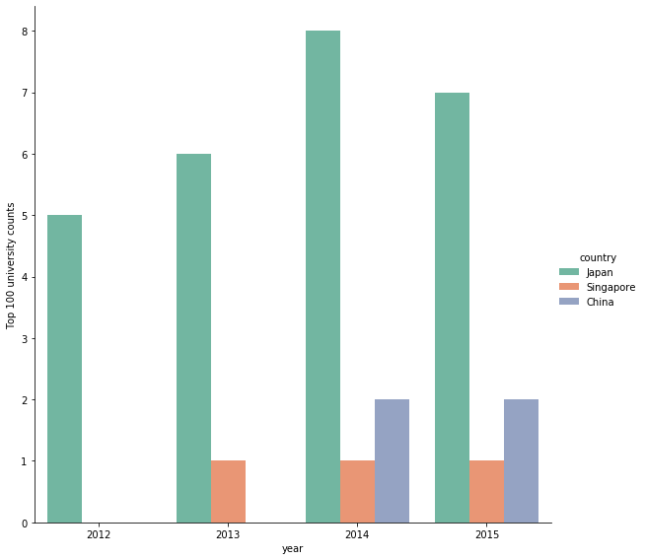
Question 05:
The trend for the count of top 100 universities for Japan, China and Singapore for years 2012 - 2015
Notes:
In this Grouped Bar Chart, we can see the numbers of universities for Japan, China and Singapore between 2012 to 2015 that gets onto the Top 100 ranking.
Japan had numbers of universities on Top 100 increased for the first 3 years and on 2015 the number dropped out by 1.
Singapore didn’t get onto top 100 on 2012 and 2013 is the year they got into Top 100 world rank, however it remain stagnant in next 2 years
China didn’t have universities get into first 2 years and when they got into the Top 100 world ranking, they have 2 universities go onto the list on consecutive years

Slide 14
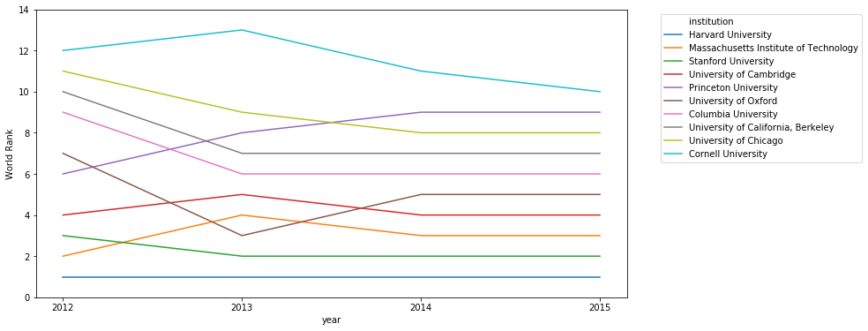
Question 06:
For top 10 universities in 2015, what was the trend for world_rank for those universities across all the years? Which universities generally improved, and which ones declined in world_rank?
Notes:
I choose lineplot as it able to give me a quick view of comparison between these universities across the year.
[Quick run through the increased & declined of the world_rank]

Slide 15
Part C: Open-ended Question

Slide 16
Choice: Option 01
What are some of the factors (variables) that may be related to the world_rank and/or score? Is there any trends indicating shift in importance of factors influencing world_rank over the years or between countries?
Large Dataset, find it hard to focus on the analysis
Decided to narrow it down to Top 10 World Rankings across all years
It may not be excellent analysis, but it’s able to do some study on the patterns or trends

Slide 17
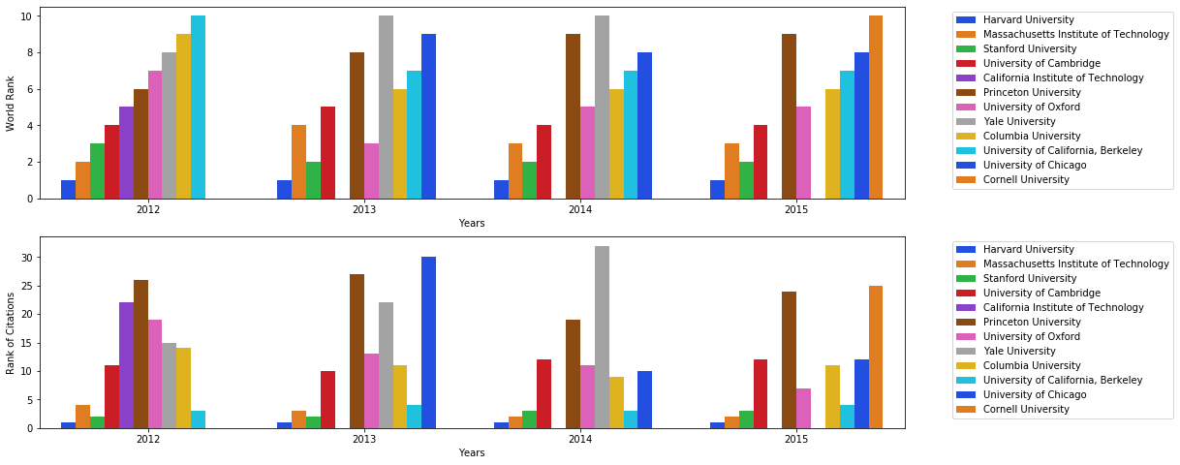
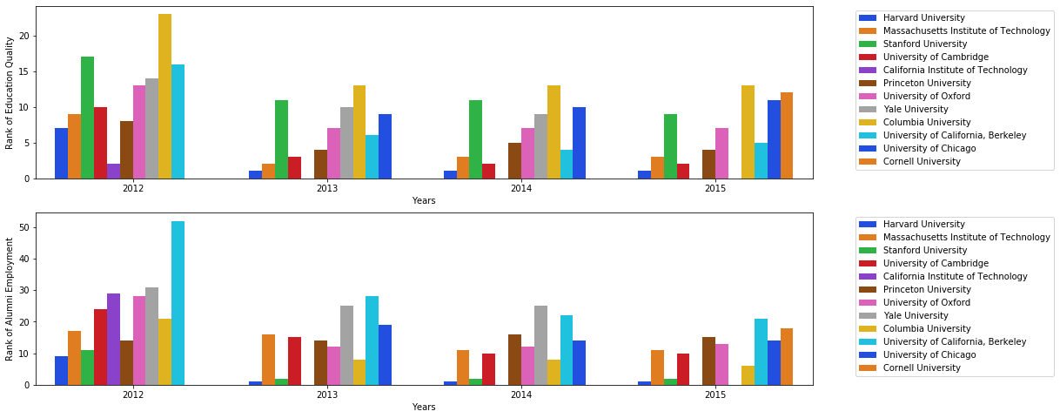
Analysis based on Universities in Top 10s between 2012 to 2015
Notes:
Among the 3 factors here, Rank of Alumni Employment is quite a key that influenced the World Ranking of Universities.

Slide 18
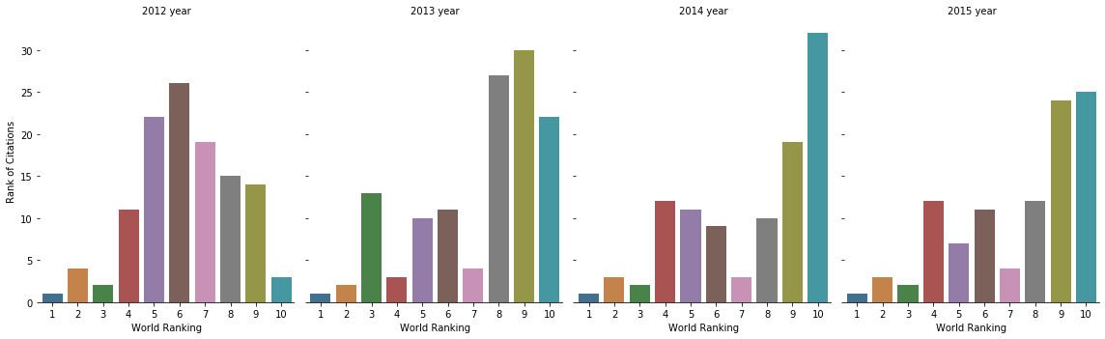
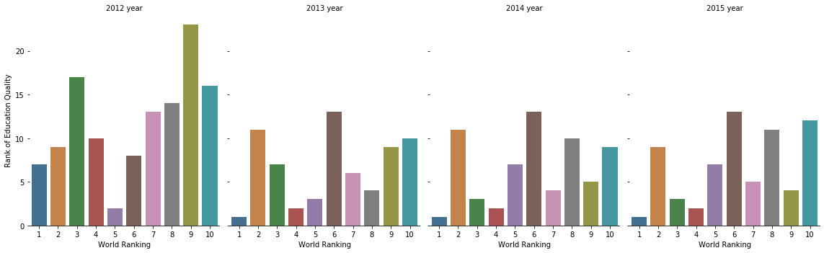
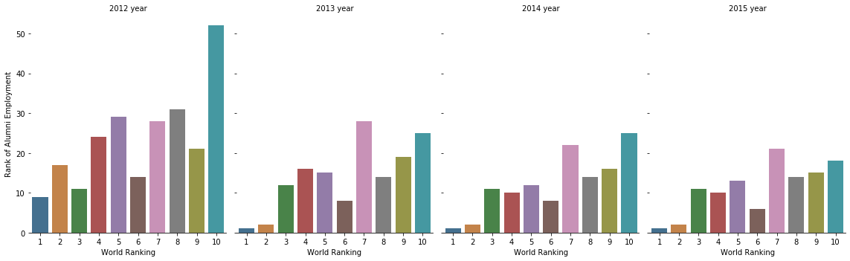
Analysis based on World Ranking between 2012 to 2015

Slide 19
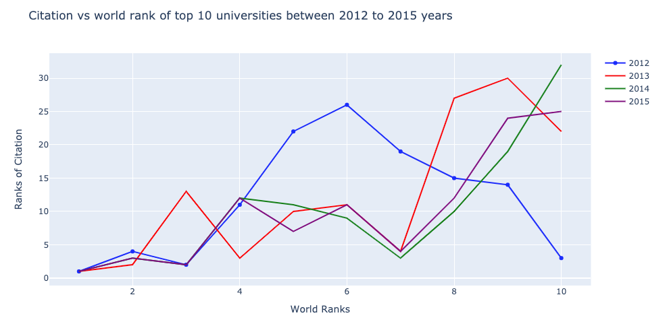
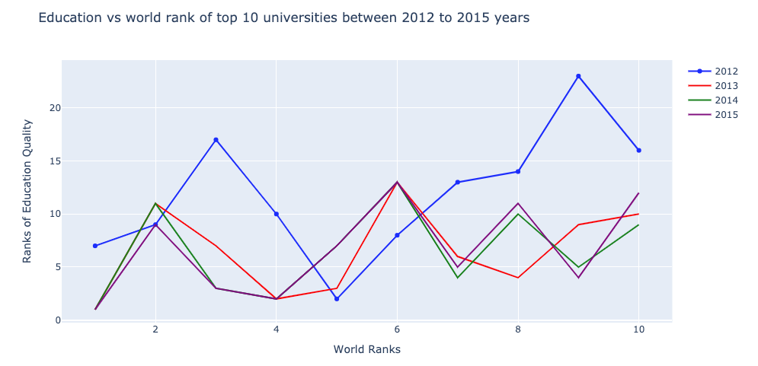
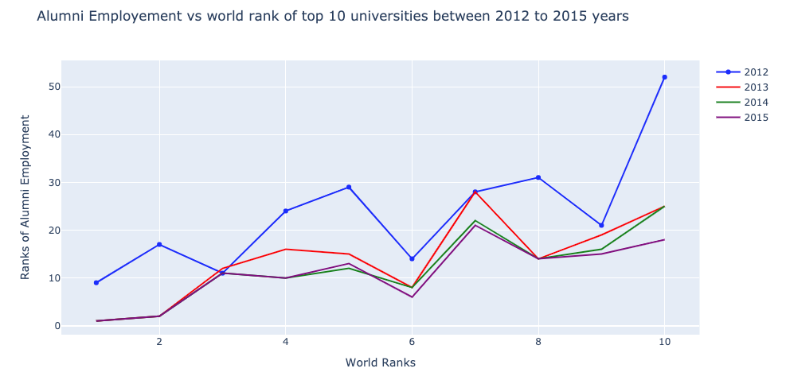
Analysis of Factors vs World Rank of Top 10 Universities between 2012 to 2015

Slide 20
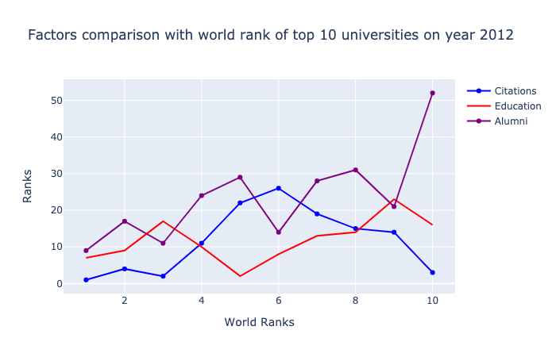
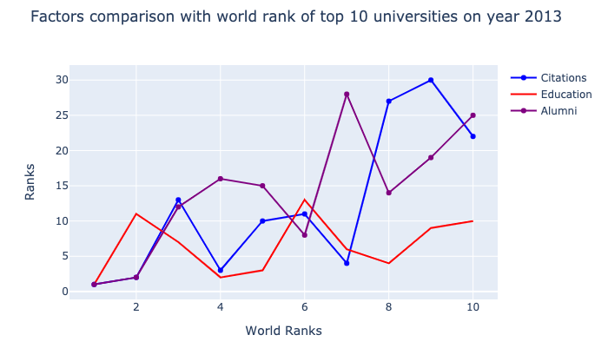
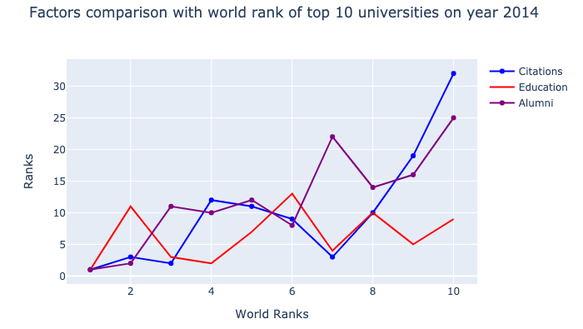
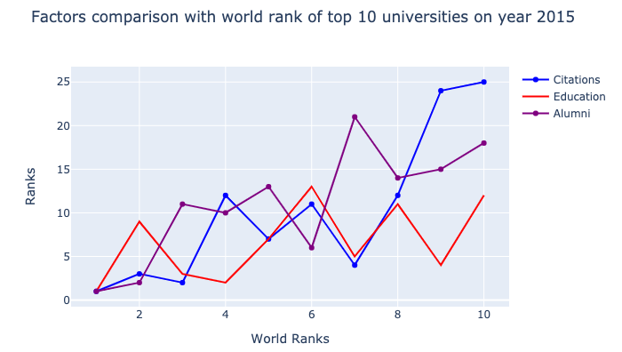
Factors comparison with World Rank of Top 10 Universities based on yearly

Slide 21
Overview
Simple yet complex dataset
Numeric data, however these integers it’s meant for rankings hence lesser mathematical methods can be rely on to assess the data.

Slide 22
End of Presentation -
Thank you for your time!

